Slide 1

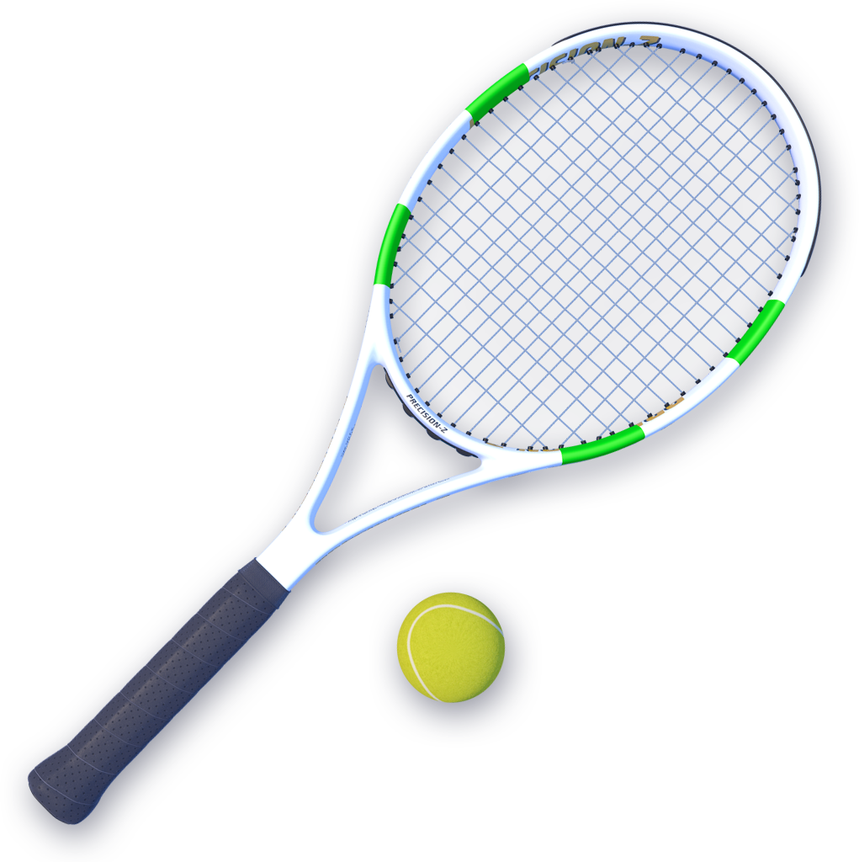

Project presentation
2D TENNIS
Applied Deep Learning
Lucija Aleksić

Slide 2

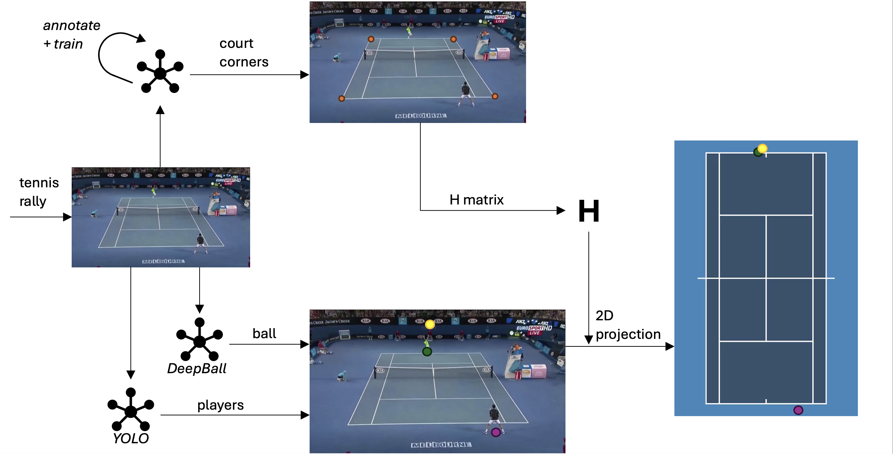
OVERVIEW
1
3
2
Notes:
- brief overview
- project is about 3D to 2D match conversion
1 - detecting and refining court corners -> Homography matrix
2 - detecting players
3 - shortly about tennis bal ldetection

Slide 3

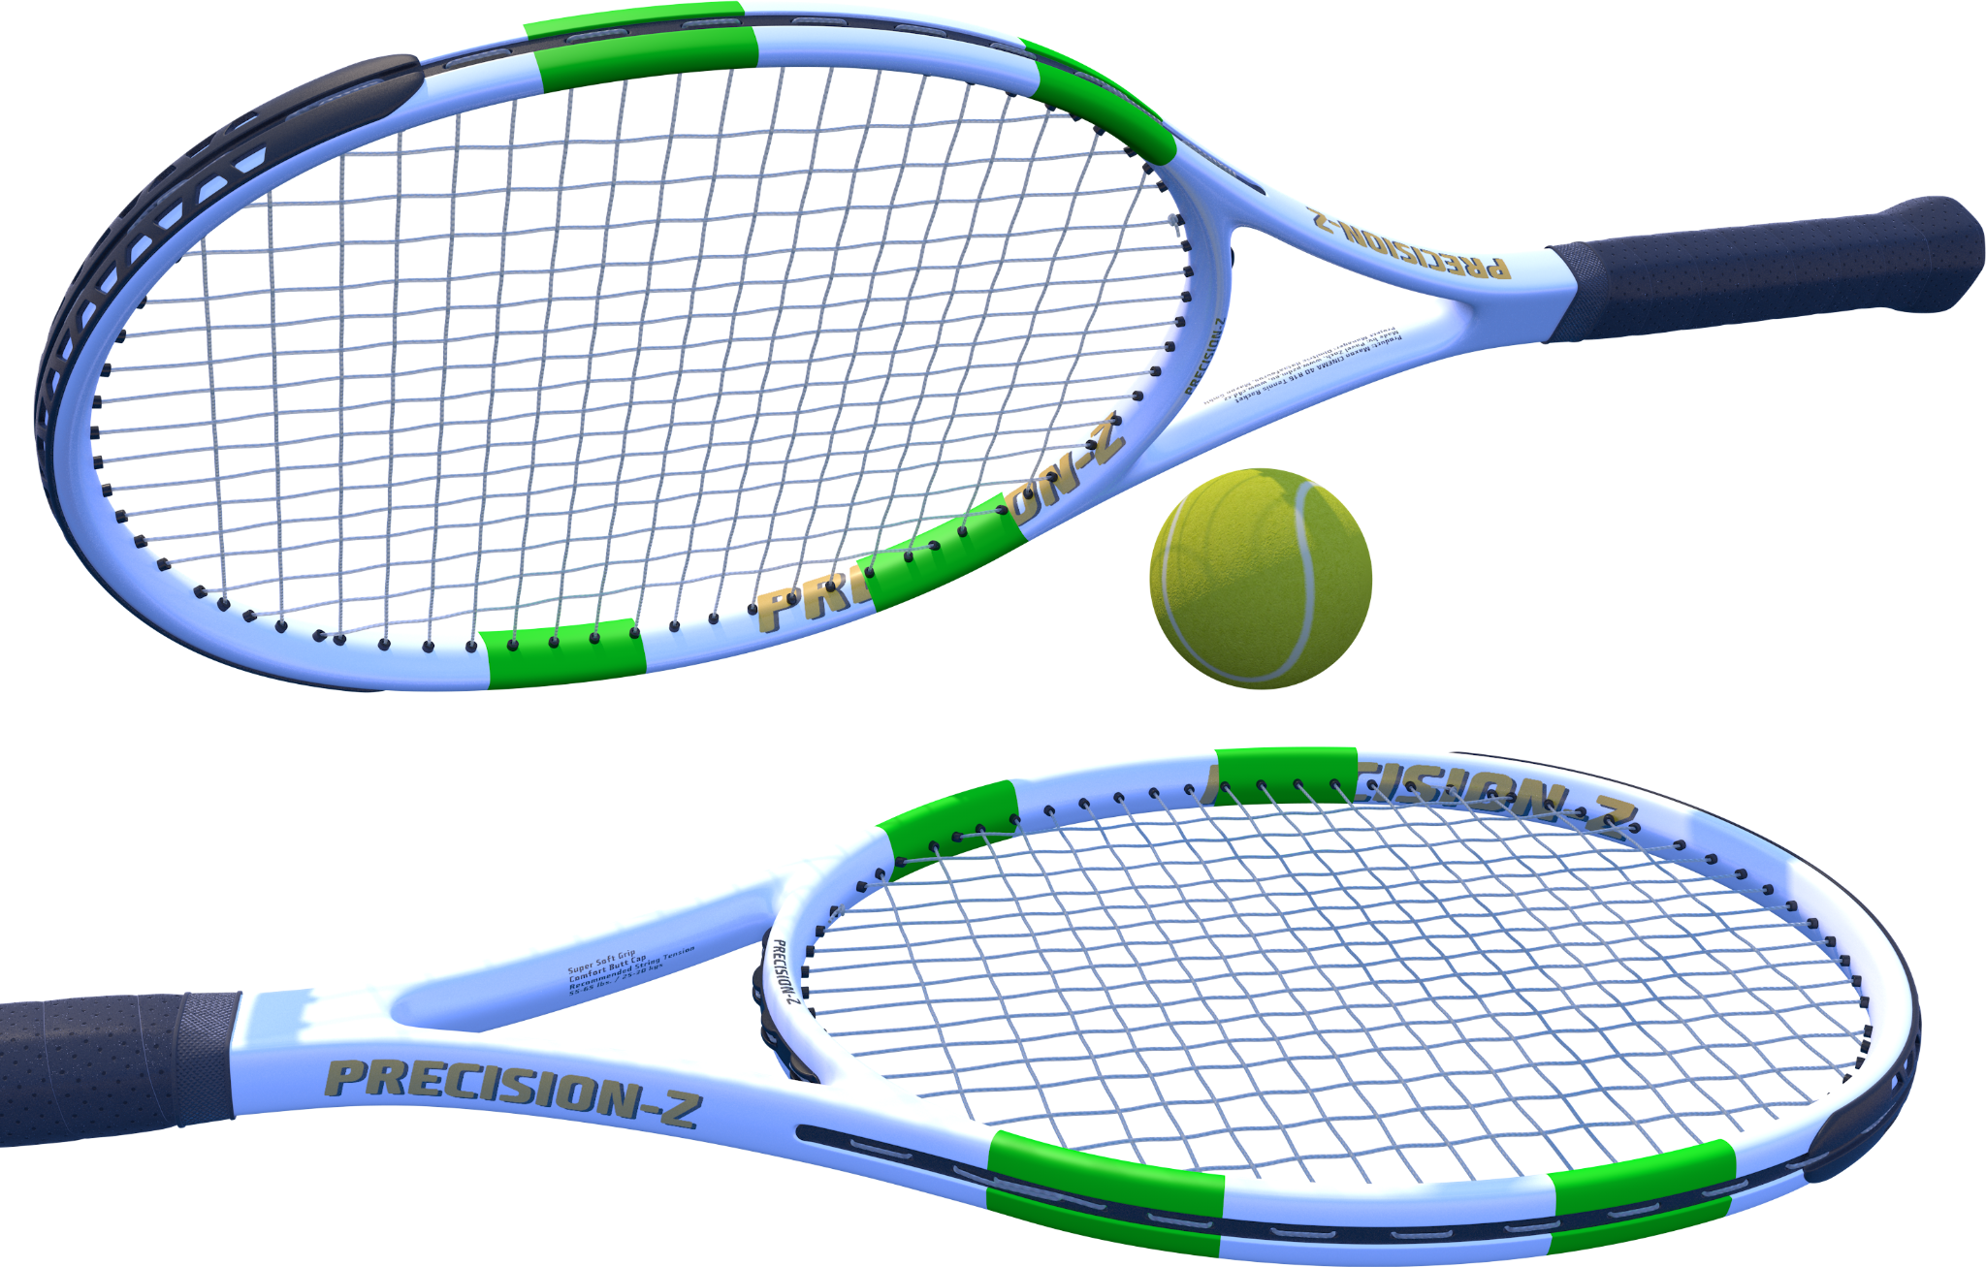
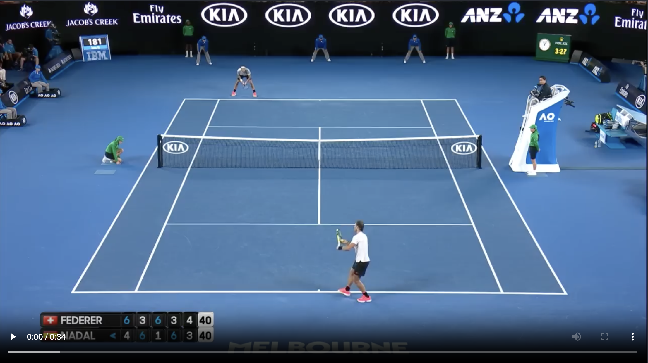
DATA
• Videos of tennis rallies from Australian Open are split into frames
• In total 4 videos totaling ~3:30 min of content
Notes:
- before models - data
- from AO channel, clean quality data
- 4 videos split into frames

Slide 4
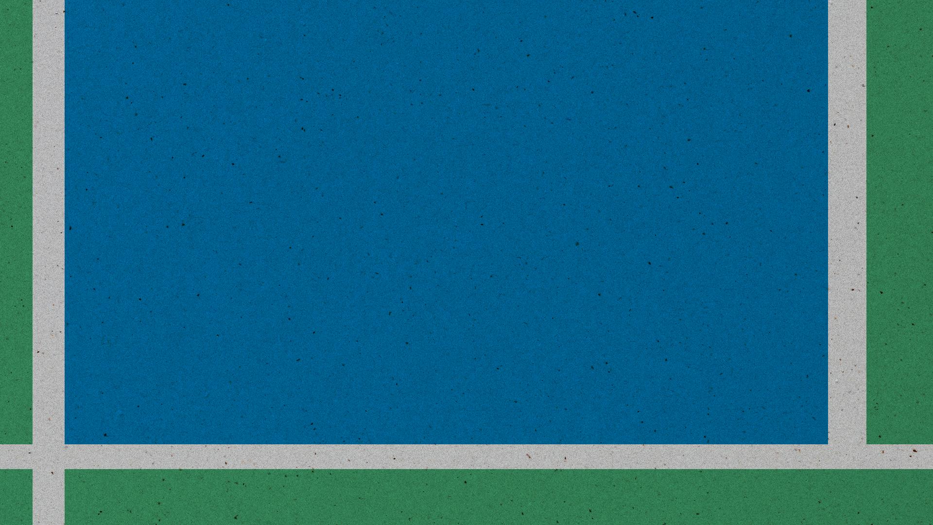
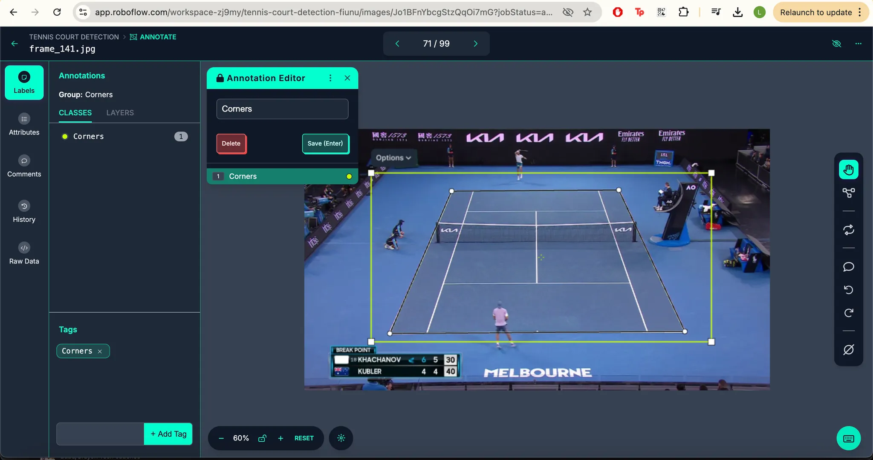
COURT DETECTION
Data annotation & training
• Roboflow for data augmentation and annotation
• 191 frame → 459 augment.
• Model yolov8x fine tuned
on Google Collab
Notes:
- first part of court detection is training the model
- I used tool roboflow
- augmented each image with saturation and exposure
- finetuned yolo v8x on the data

Slide 5
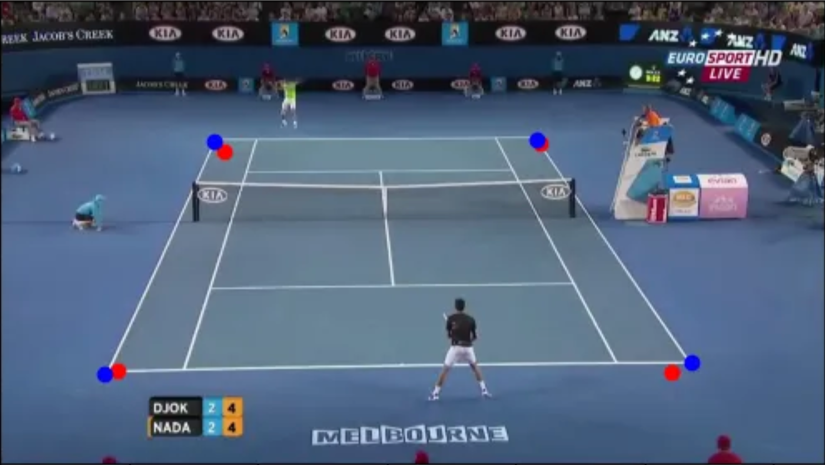
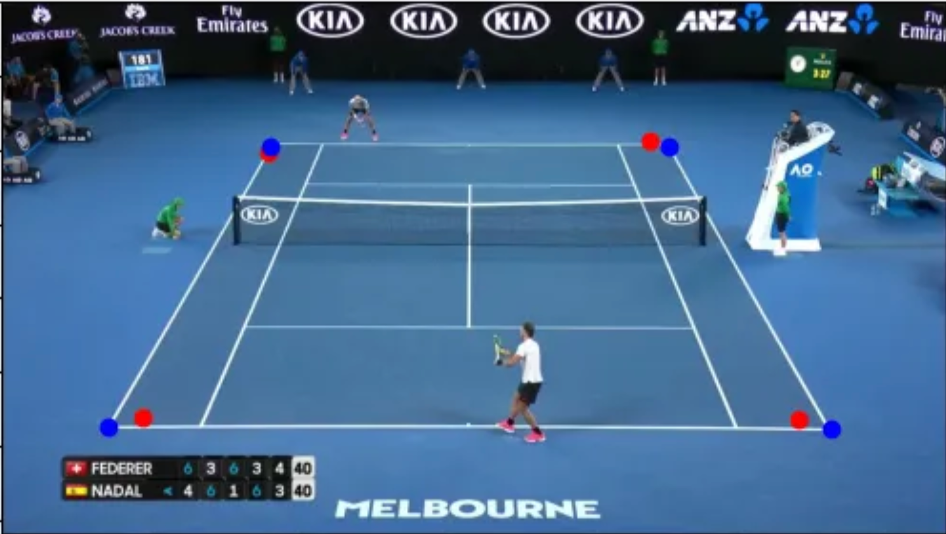
COURT DETECTION
Keypoint refining
• Actual model performance wasn’t as good
• Refining steps:
1. Crop around KP 2. Detect baselines with cv2.HoughLinesP
3. Mask white pixels
4. Find most right/left points
Notes:
- however actual model perf. wasn't good as you can see by the red dots which are predictions on the right images
- I refined the points in the following way
- that leads to almost perfect blue corrected points

Slide 6

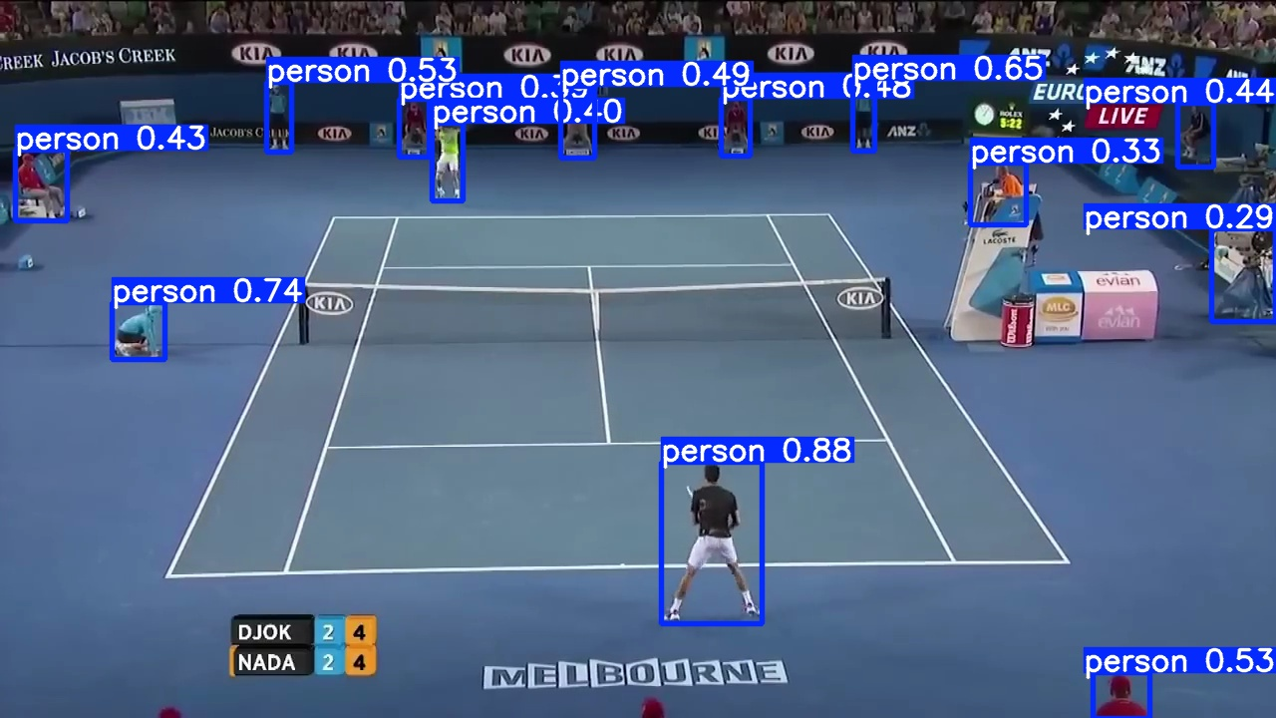
PLAYER DETECTION
• People detection using yolov5s model
• The two players identified by the two
people closest to the baselines at the start of the rally
Notes:
- I firstly detect all people, which there were much more than you'd expect, by using a pretrained yolo model
- then I choose 2 people closest to the baselines

Slide 7

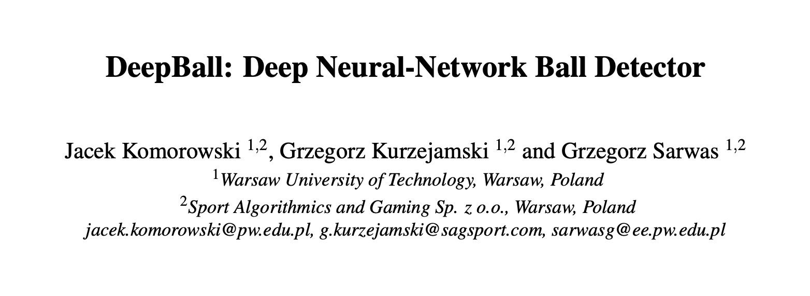

BALL DETECTION
• Tried approaches:
1. DeepBall
2. WASB model
3. Tennis Tracking model
4. different YOLOs
• No luck :(
Notes:
- now the problematic part
- it was much harder than expected due to speed and frame rate sometimes it was just a blow or even not visible
- these are all the approaches I tried but with no luck

Slide 8
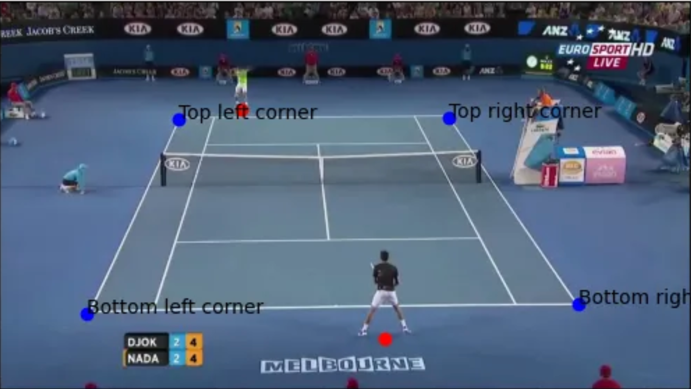
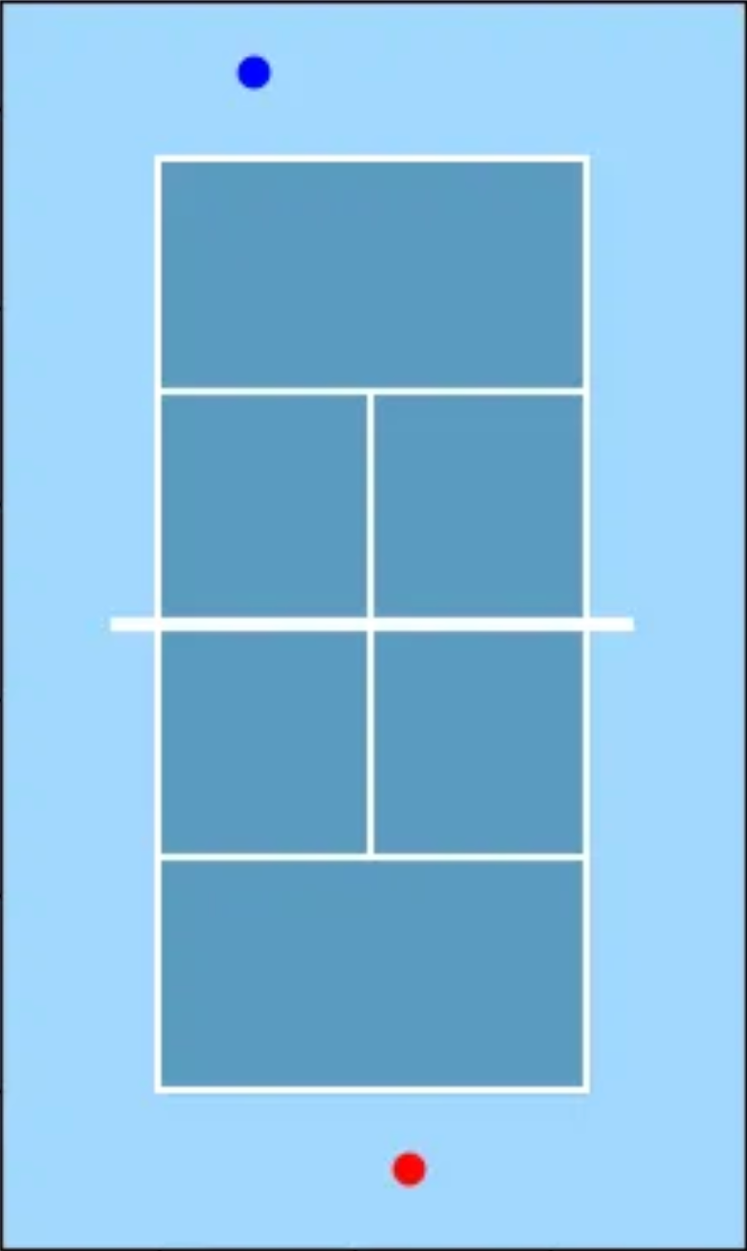
„DEMO”
Notes:
- my original idea was to have a video converted to 2D but I didn't manage
- I will just demonstrate how image inference is done
- I kept the overview on the top as a reminder
- court corners -> homography -> players -> tennis ball in an ideal world (even here isn't visible cuz rafa is serving) -> project and visualize

Slide 9

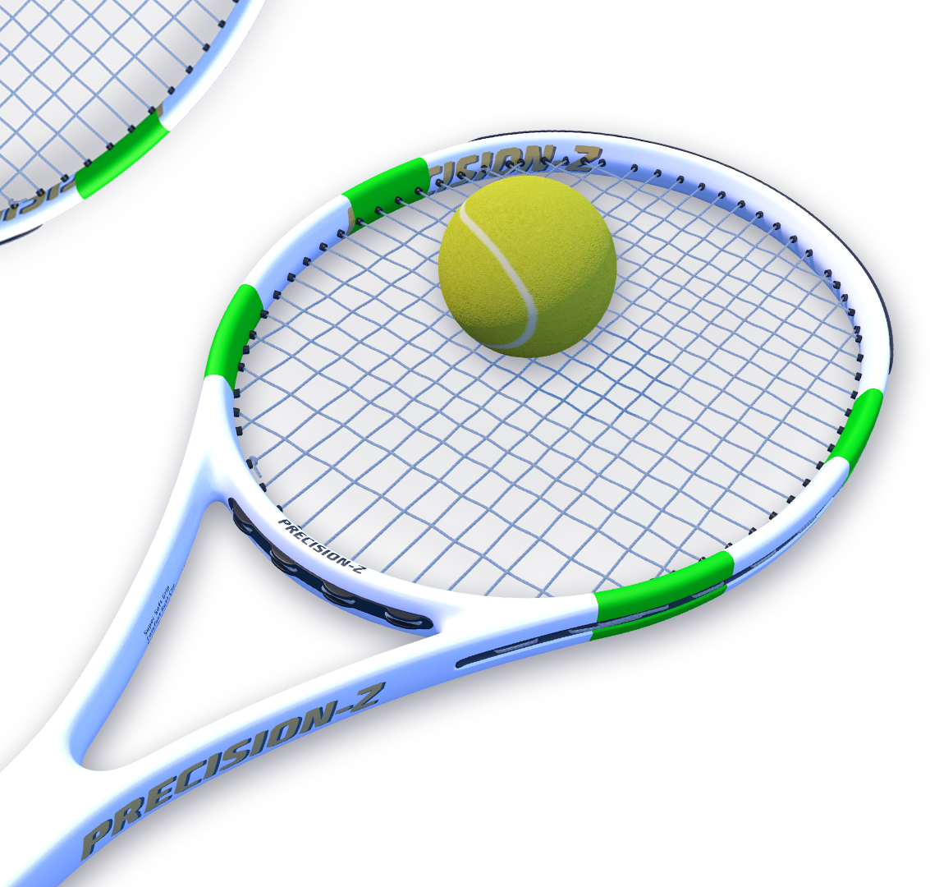
THANK YOU!

